Slide 1


Slide 2
Linear Regression

Slide 3
Definition
Linear Regression algorithm is a statistical model used to predict relation between dependent and independent variables.
Predict real-valued output
Dependent Variable: The variable you want to predict. It is the outcome you're interested in. [Y]
Independent Variables: The variables that influence the dependent variable. They are the factors you use to make predictions. [X1,X2,X3….Xn]

Slide 4
Use case
Housing Prices Prediction: predict housing prices based on features such as location, size, number of bedrooms, and other property attributes.
Employee Salary Prediction: predict employee salaries based on factors such as years of experience, education level, and job position.
Weather Forecasting: predict temperature or rainfall based on historical weather data and other related variables.

Slide 5
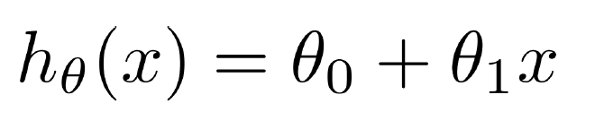
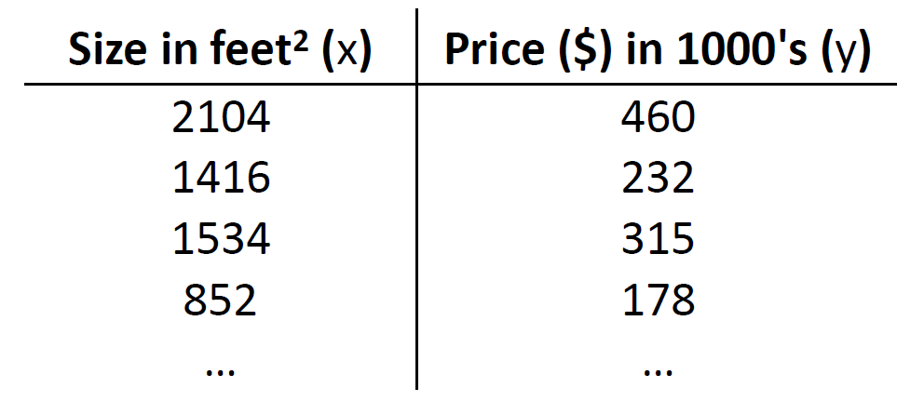
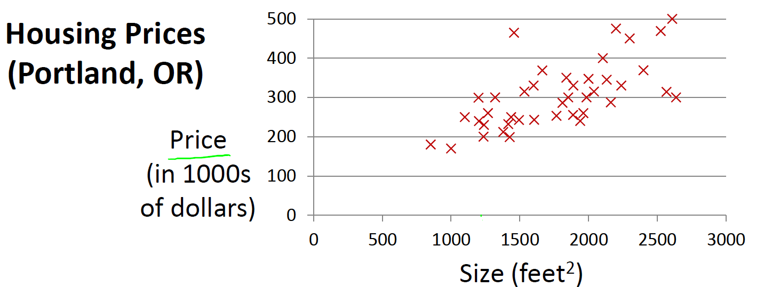
Housing Prices

Slide 6
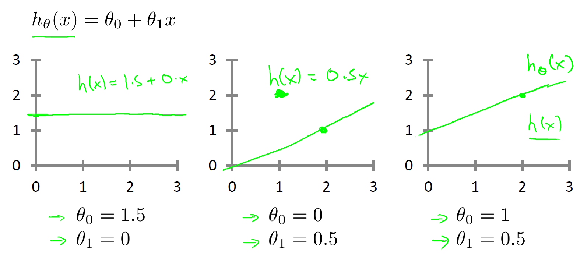
Linear Regression

Slide 7
Gradient Descent for Linear Regression
A linear regression model can be trained using the optimization algorithm gradient descent by iteratively modifying the model’s parameters to reduce the mean squared error (MSE) of the model on a training dataset.
To update θ1 and θ2 values in order to reduce the Cost function (minimizing RMSE value) and achieve the best-fit line the model uses Gradient Descent.

Slide 8
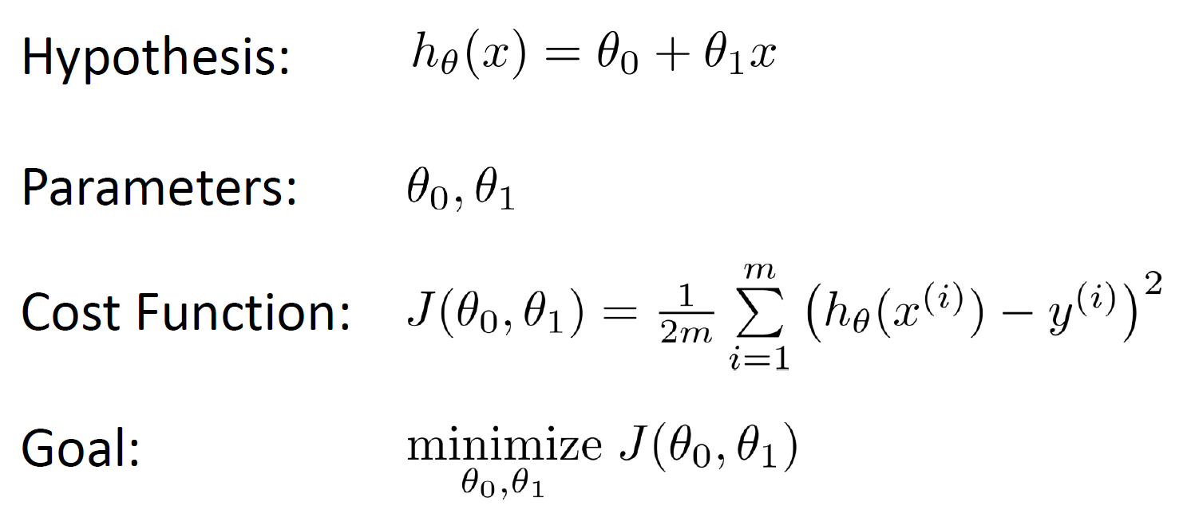
Formula

Slide 9
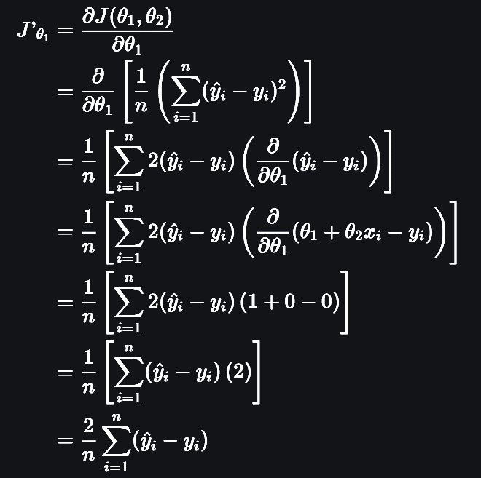
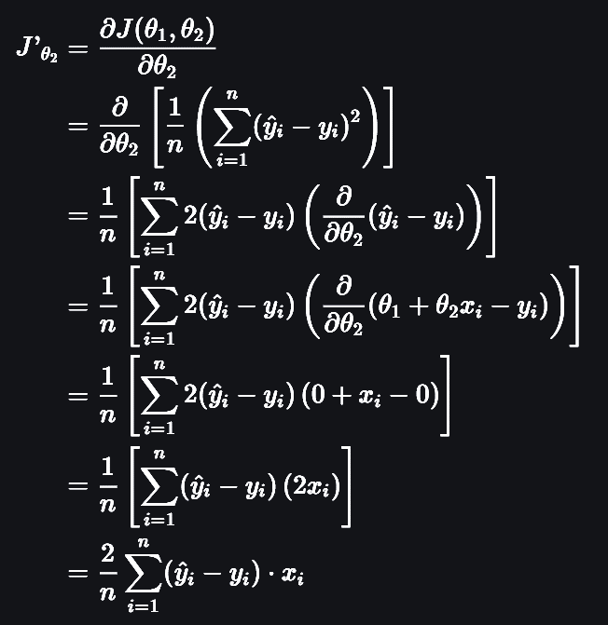
Gradient Descent for Linear Regression

Slide 10
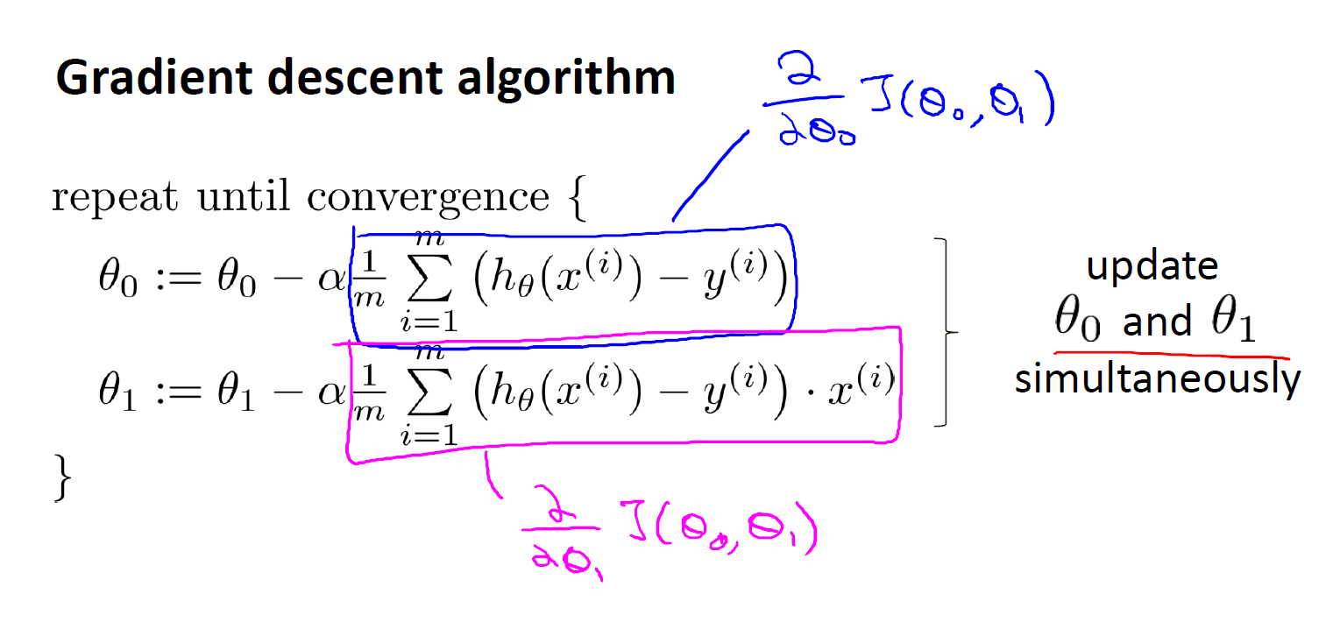
Gradient descent algorithm

Slide 11
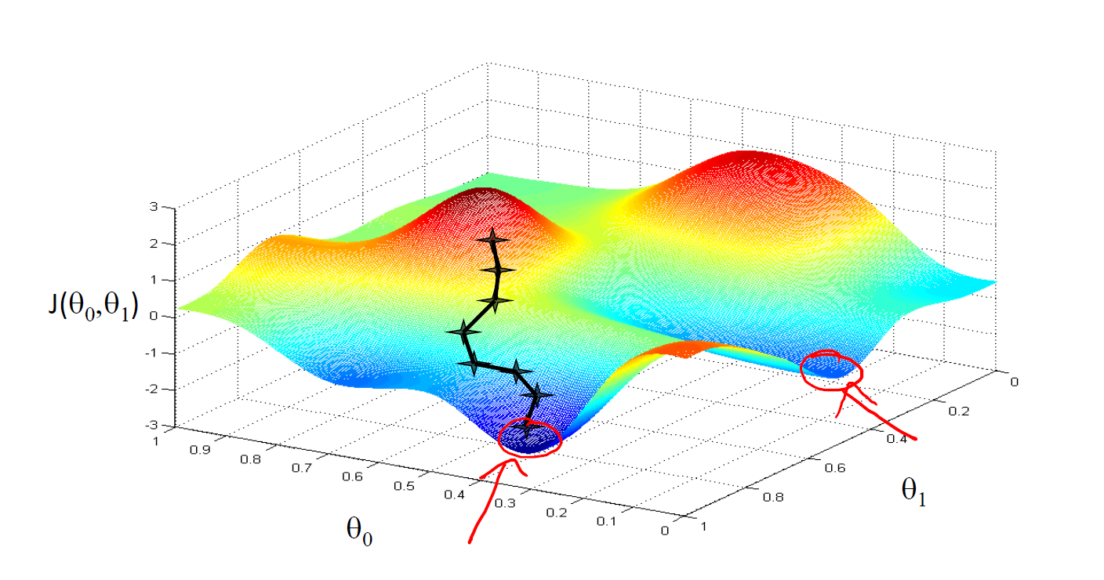

Slide 12
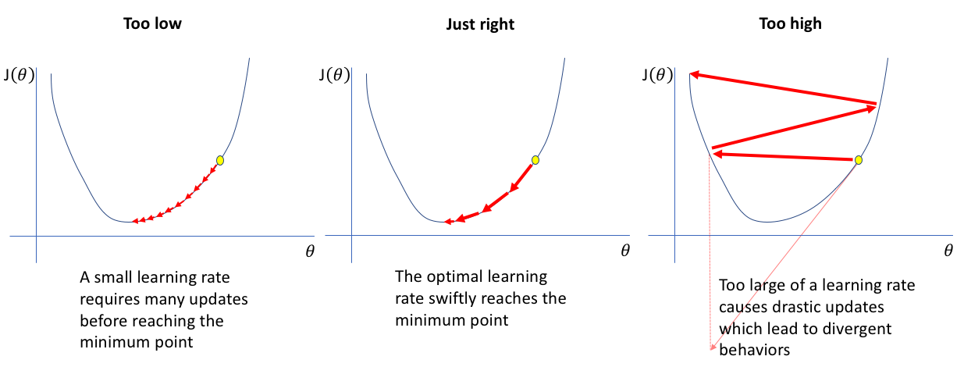
Learning Rate

Slide 13
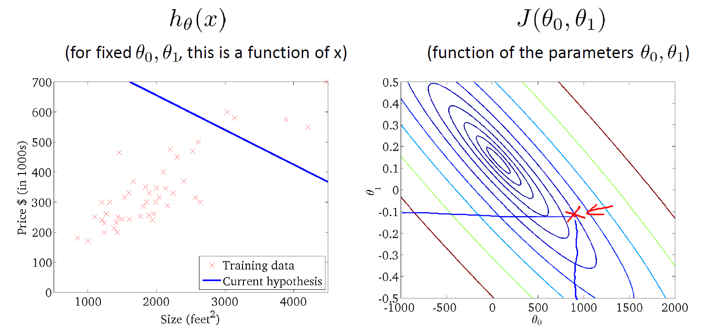

Slide 14
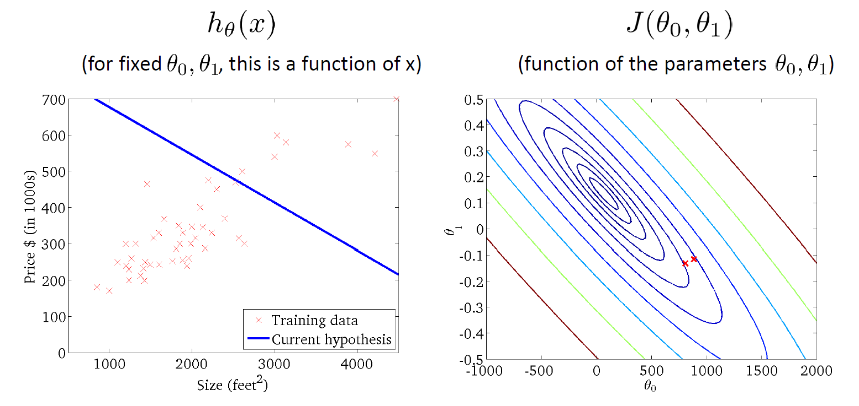

Slide 15
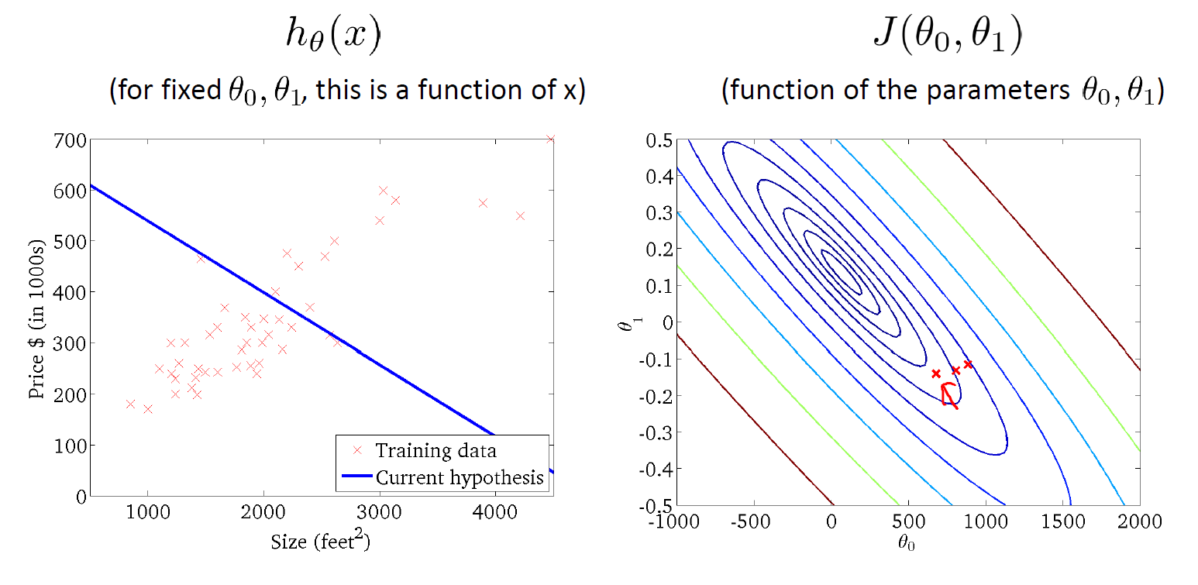

Slide 16
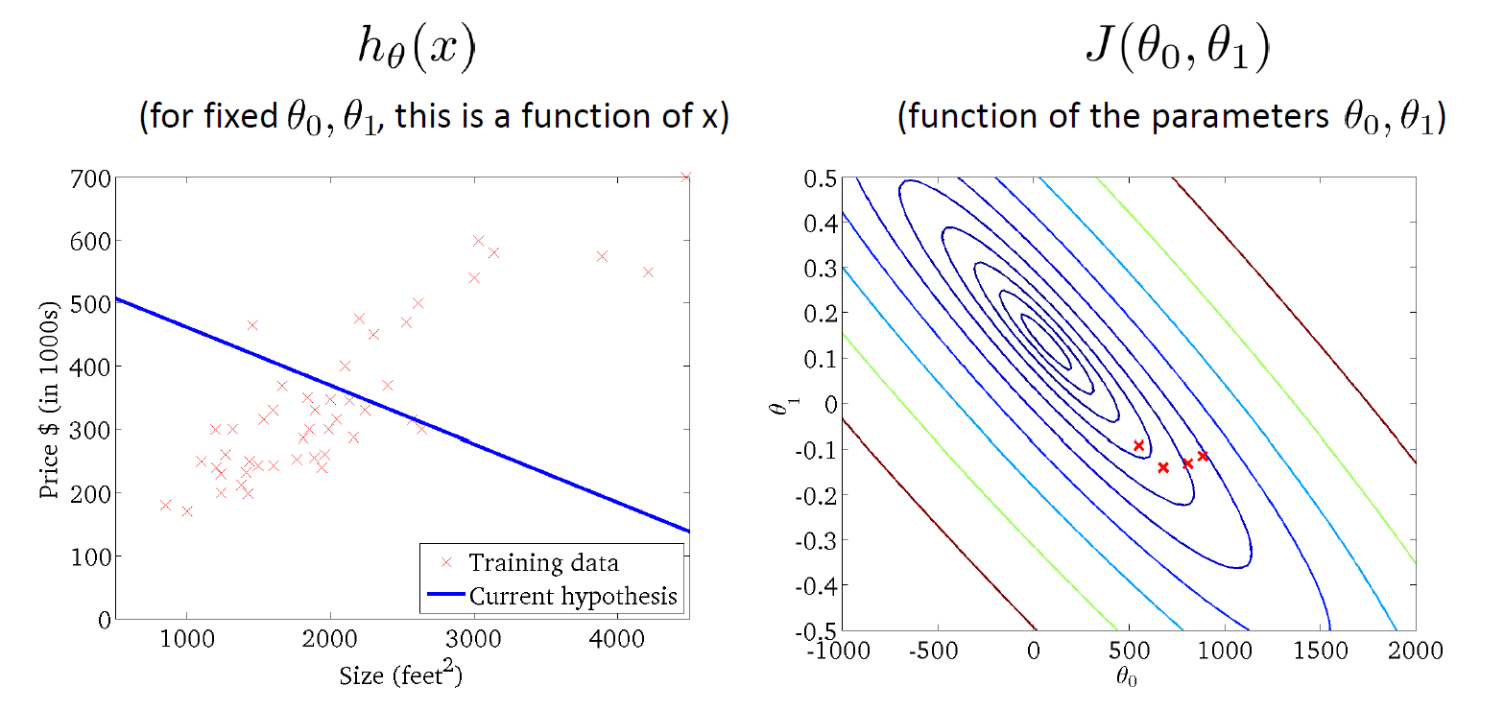

Slide 17
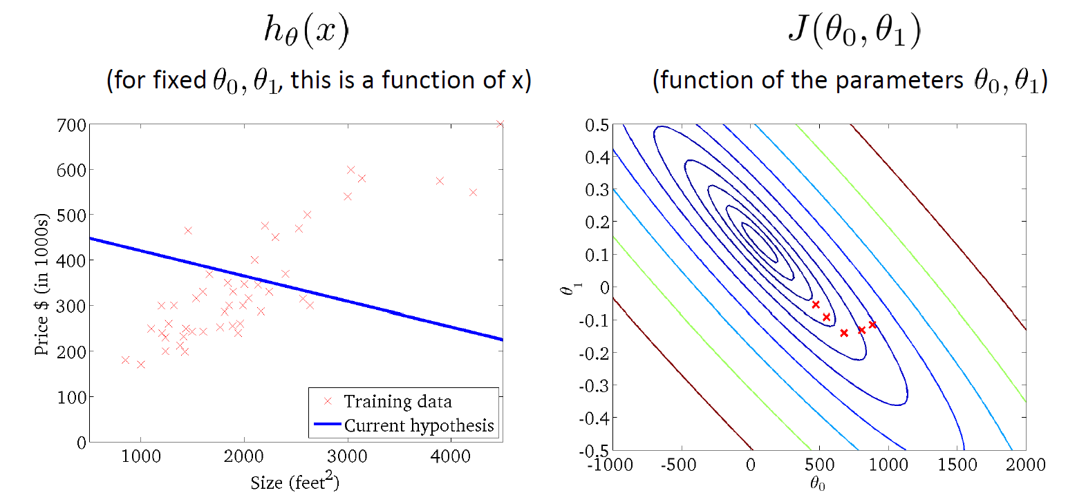

Slide 18
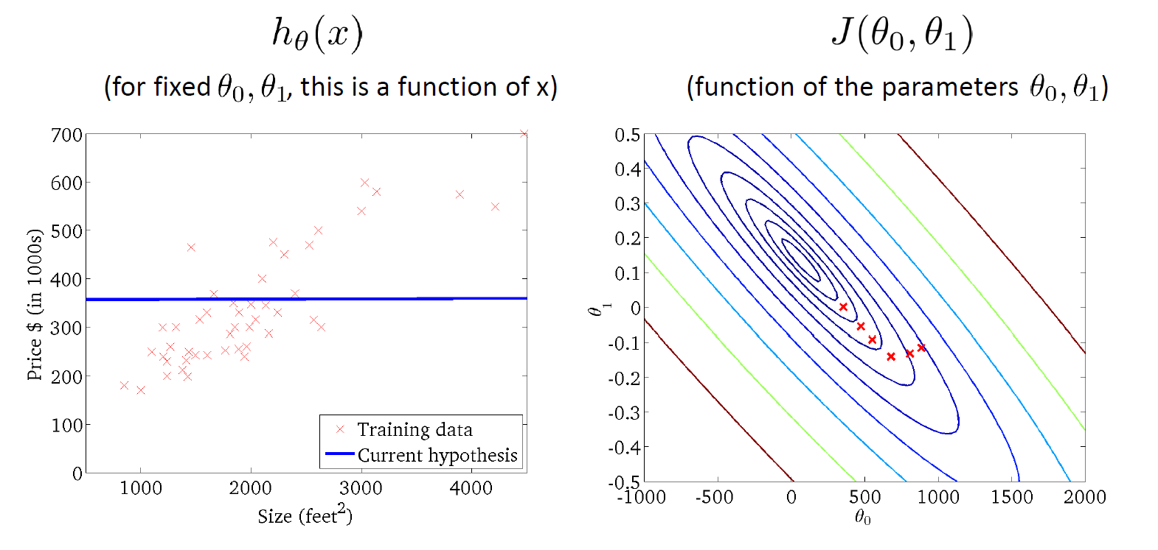

Slide 19
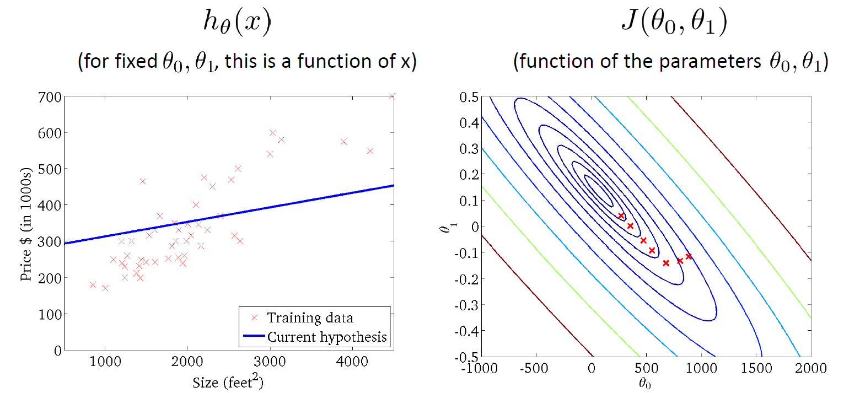

Slide 20
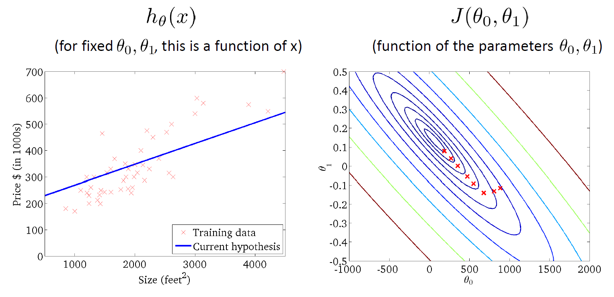

Slide 21
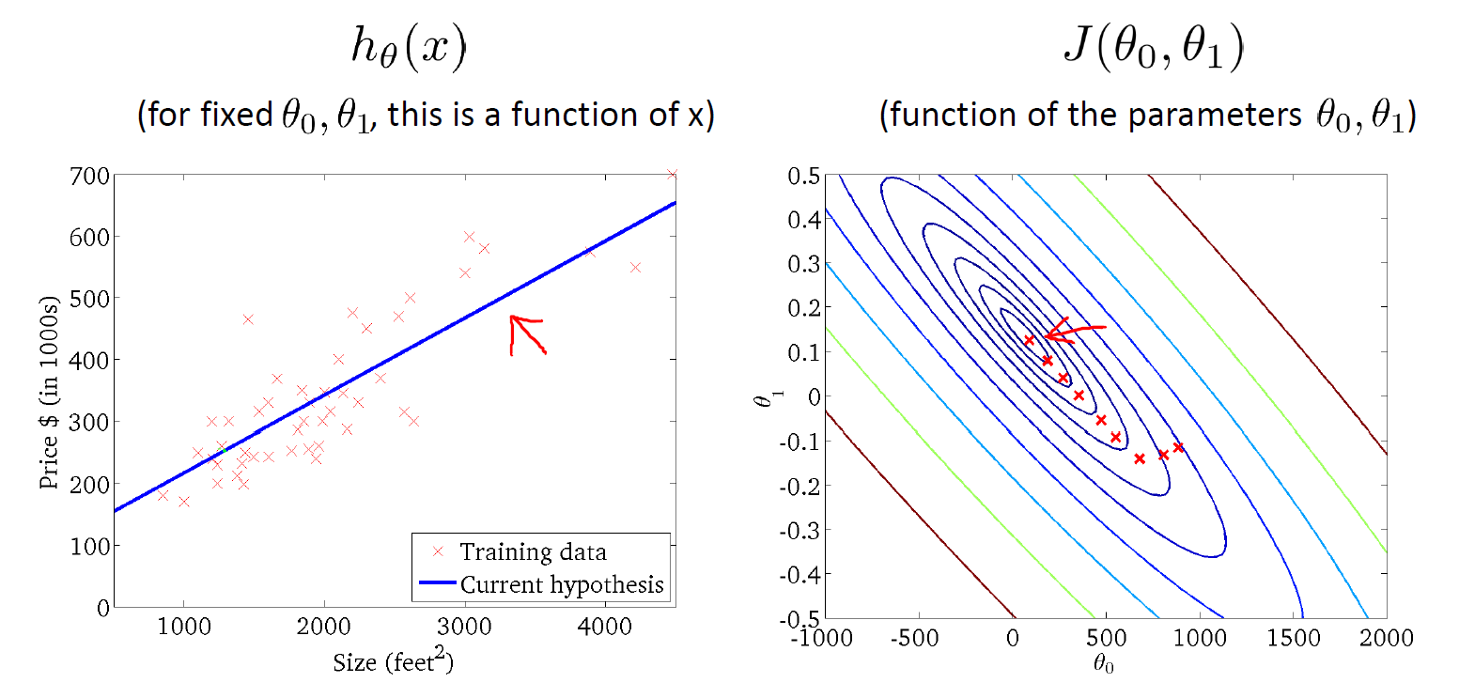

Slide 22
Evaluation Metrics
Regression

Slide 23
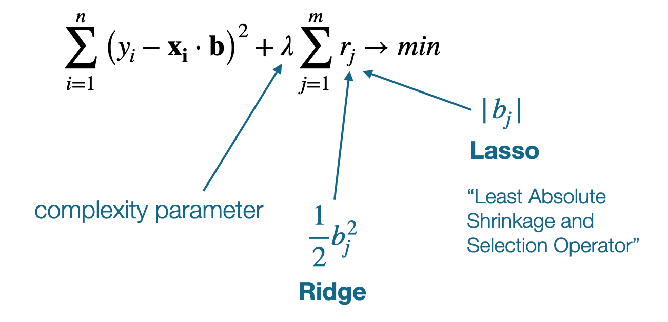
Type of Linear Regression

Slide 24
Logistic Regression

Slide 25
Definition
Logistic Regression is a supervised machine learning algorithm that does binary classification of outcome based on the probability.
Logistic Regression provides binary or discrete outcome either true or false, 0 or 1 , Yes or No.

Slide 26
Use case
Identifying spam mails.
Predicting if a financial transaction is fraud or not.
Disease Prediction such as heart attack

Slide 27
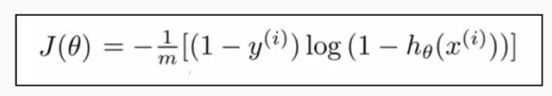
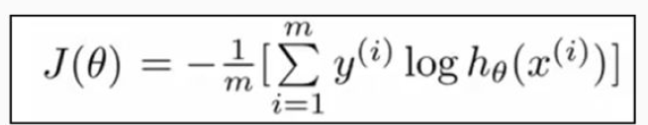
Formula
y = 0
y = 1

